Slide 1
Myth, Mysticism, and Religious Consciousness Dr. Stephanie Spoto Monterey Peninsula College
Gentrain
6 September 2018

Slide 2
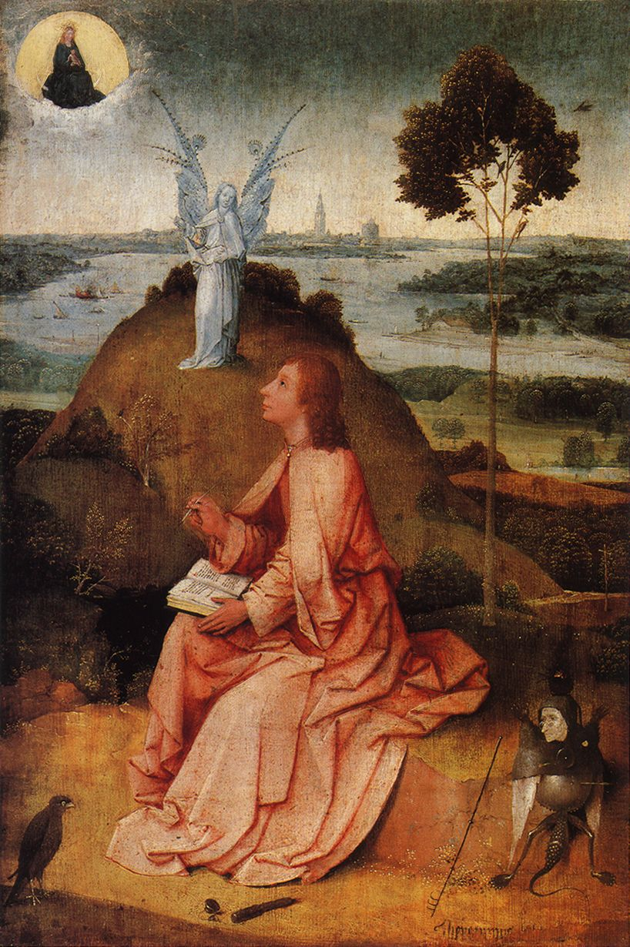
Religious experience Religious Consciousness
RELIGION may be defined as beliefs and patterns of behavior by which people try to deal with what they view as important problems that can’t be solved by other means: e.g. the need to confront and explain life and death.
All cultures have religions, which are powerful and dynamic forces in human society.
To overcome limitations, people often turn to supernatural beings and powers → gods and goddesses, ancestral and nature spirits, impersonal powers.
Religion presupposes the existence of supernatural beings and powers with interest in human affairs—so to these beings and/or powers, humans can direct appeals for aid.
Cora Agatucci, “Culture, Religion, and Myth,” 2010.

Slide 3
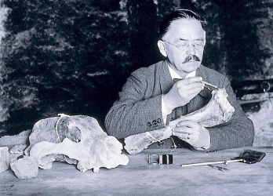
Prehistoric religion
Explanation for the afterlife
Intentional burial with goods
Emil Bächler in particular suggests (based on archeological evidence from Middle Paleolithic caves) that a widespread Middle Paleolithic Neanderthal bear-cult existed
Through ritual (religion in action)—e.g. prayer, song, dance, offerings, sacrifices—people worship, trying to ward off misfortune and/or entreat supernatural powers and beings to aid and protect, and help humans prosper.
Ina Wunn, “The Beginning of Religion,” Numen, 2000.
Cora Agatucci, “Culture, Religion, and Myth,” 2010.

Slide 4
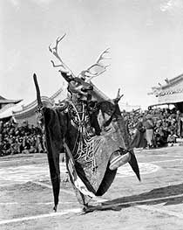
Human and animal connections to the divine
Most cultures have religious specialists—e.g. shamans, priests, theologians—who are skilled at dealing with supernatural deities/powers, and can mediate between the spiritual and human worlds.
Religion reduces human anxieties
explaining the unknown or making it understandable
providing comfort in times of crisis
sanctioning a range of human conduct with notions of right and wrong
setting precedents for acceptable behavior
transferring the burden of making decisions from human to supernatural beings.
Tuvan Shaman, 2016.
Cora Agatucci, “Culture, Religion, and Myth,” 2010.
Dancing deer at the Tsam festival in Ulaan Baatar (before 1937)

Slide 5
Myth and instructive story-telling
MYTHOLOGY can be defined as a body of interconnected myths, or stories, told by a specific cultural group to explain the world consistent with a people’s experience of the world in which they live.
Myths often begin as sacred stories that "offer supernatural explanations for the creation of the world . . . and humanity, as well as for death, judgment, and the afterlife" ("Myth" 284).
A mythology or belief system often concerns supernatural beings/powers of a culture, provides a rationale for a culture’s religion and practices, and reflects how people relate to each other in everyday life.
"Myth." In The Bedford Glossary of Critical and Literary Terms. 2nd ed. Ed. Ross Murfin and Supryia M. Ray. Boston: Bedford-St. Martin's, 2003.
Cora Agatucci, “Culture, Religion, and Myth,” 2010.

Slide 6
Origin myths
Creation or origin myths explain how the world came to be in its present form, and often position the cultural group telling the myth as the first people or the "true" people.
Such sacred stories, or narratives, concern where a people and the things of their world come from, why they are here, where they are going.
Myths and mythology express a culture’s worldview: that is, a people’s conceptions and assumptions about humankind’s place in nature and the universe, and the limits and workings of the natural and spiritual world.
"Myth." In The Bedford Glossary of Critical and Literary Terms. 2nd ed. Ed. Ross Murfin and Supryia M. Ray. Boston: Bedford-St. Martin's, 2003.
Cora Agatucci, “Culture, Religion, and Myth,” 2010.

Slide 7
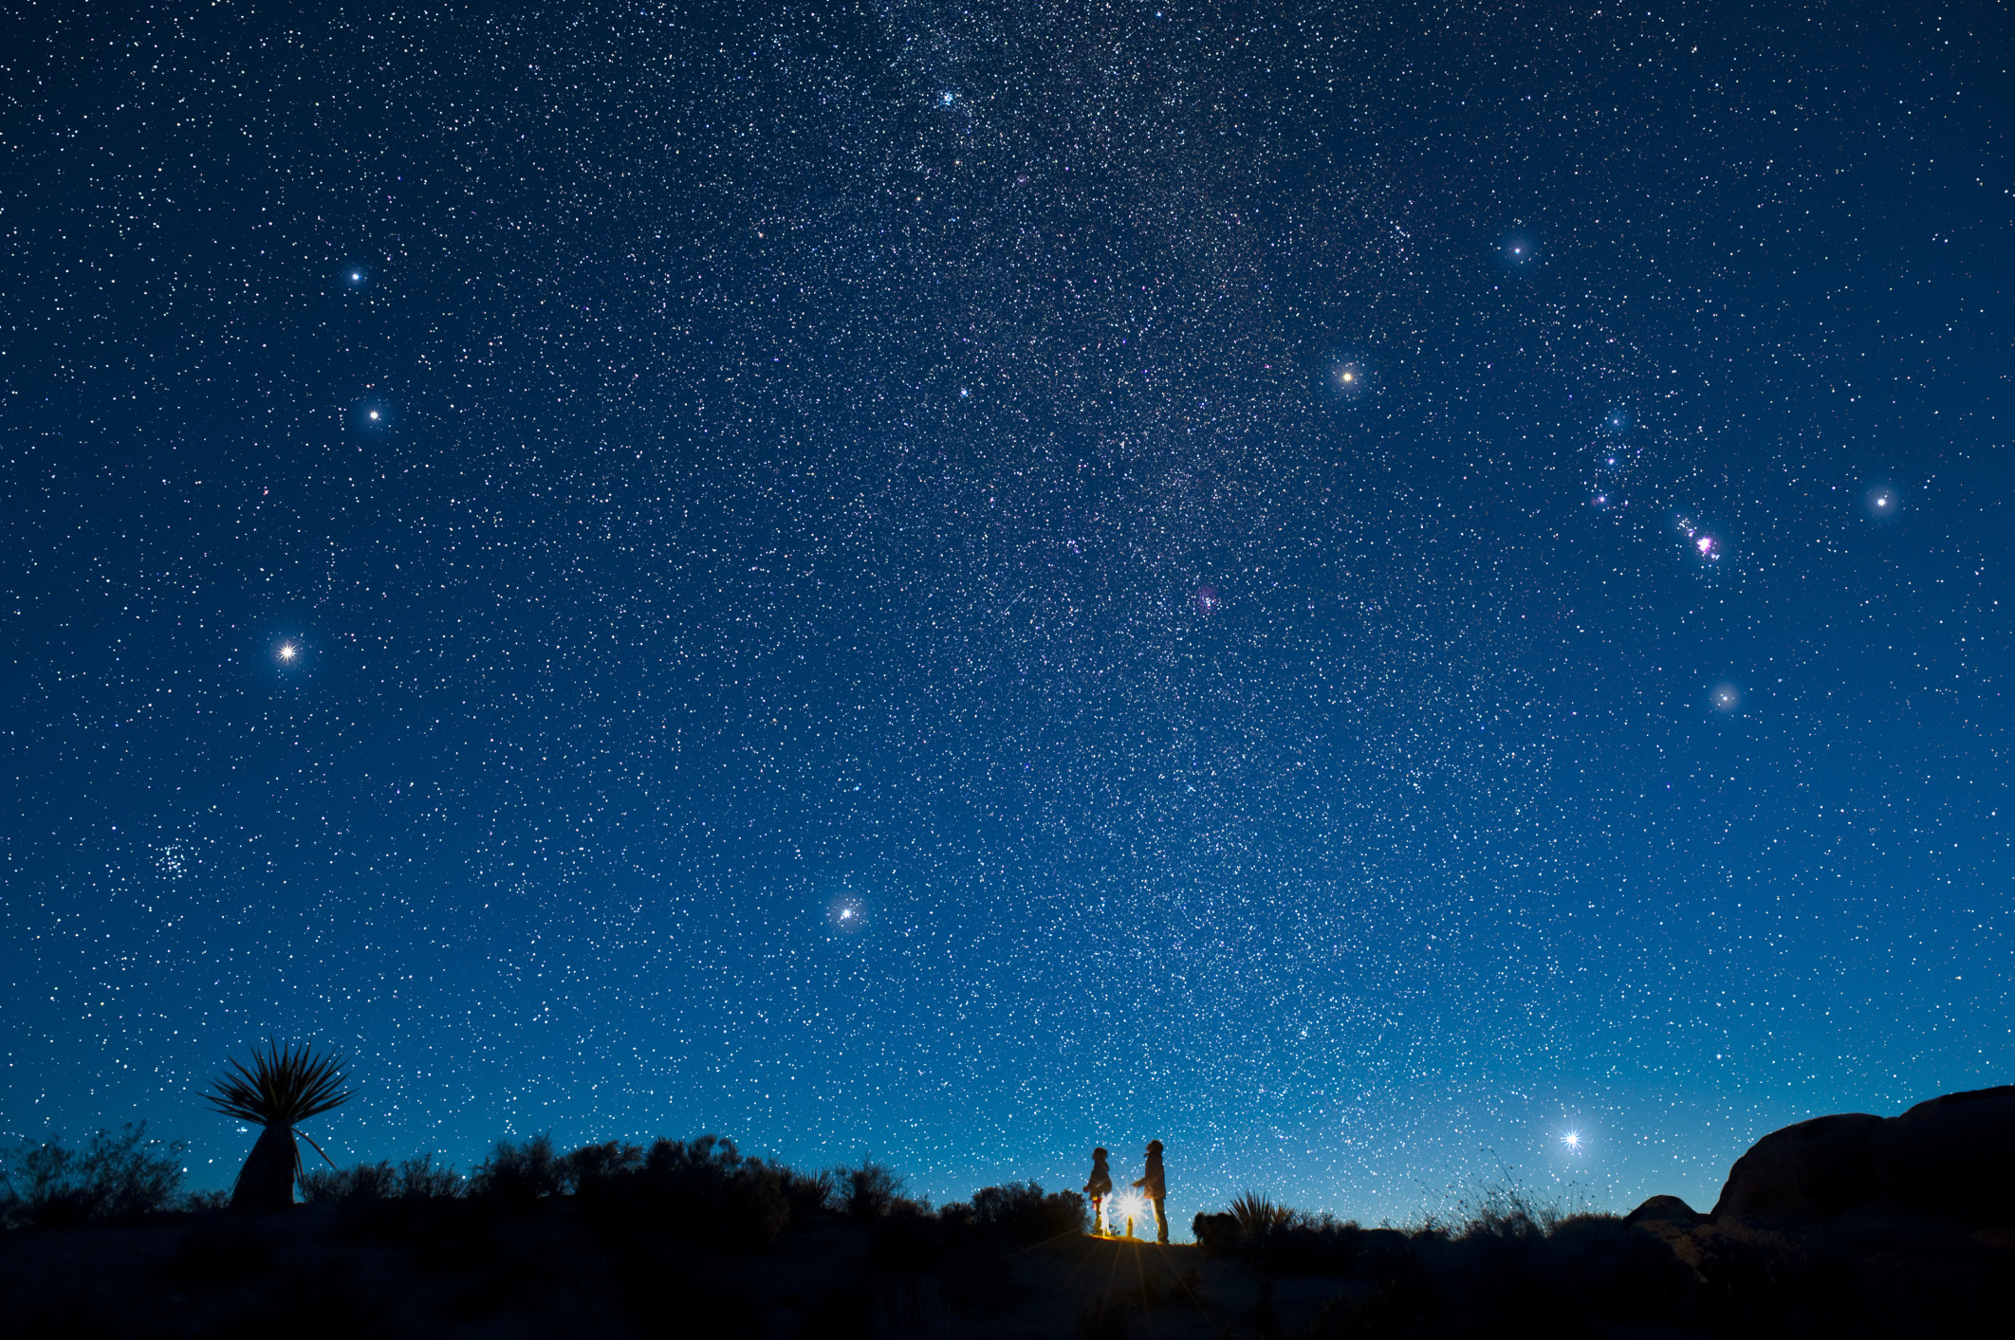

Slide 8
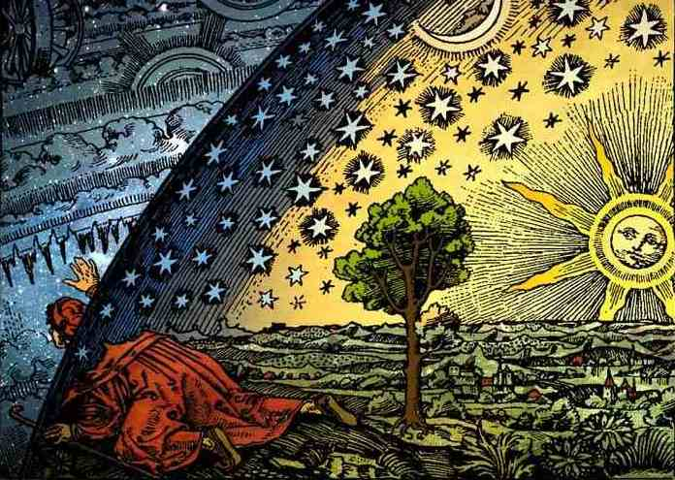
Mysticism and religious consciousness
Comes from the Greek μυω, meaning “to conceal.”
Hellenism: ‘mystical’ referred to “secret” religious rituals.
In early Christianity, “mystical” came to refer to “hidden” allegorical interpretations of Scriptures and to hidden presences. – similar to “occult”
Later, became synonymous with ‘mystical experiences’ – a direct experience of the divine.
‘Mysticism’ would best be thought of as a relation or combination of distinctive practices, discourses, texts, institutions, traditions, and experiences aimed at human transformation – mystical experiences are not the end, but the means.
Bouyer, Louis, ”Mysticism, An Essay on the History of the Word“ in Understanding Mysticism, Richard Woods (ed.), Garden City: Doubleday, 1981.
Gellman, Jerome, "Mysticism", The Stanford Encyclopedia of Philosophy (Spring 2017 Edition), Edward N. Zalta (ed.), 2017.

Slide 9
Mysticism as Divine Communion
“Mysticism is the endeavour of humans to apprehend Reality and experience the ecstasy of being in communion with God, by means of personal revelation, transcendentalism and contemplation or meditation on the Divine. It results in the freedom of the mind from the fetters of the senses and from the ordinary restrictions of social existence through the avenue of unexpected revelations. The mystic, being initiated into the mysteries of existence and the esoteric knowledge of the realities of life and death, aspires for afar, yearns for the inaccessible, and searches for the ideal heart’s compassion and the desire to know the unknown.”
Swati Samantaray, “Demystifying Mysticism: A Comparative Study of the Poetry of William Blake and Rabindranath Tagore,” The Southeast Asian Journal of English Language Studies, Vol 19 (2): 41-51.

Slide 10
Metaphysics
From the title given posthumously to Aristotle’s work: Ta meta ta phusika (To be read after Aristotle’s Physics).
Concerned with what there is, and how we know what there is.
Sometimes called “the first philosophy”.
What is really there vs. what is merely apparent (e.g. Plato’s allegory of the cave)
In popular culture, refers to the New Age movement developed in the 1970s – which drew on older forms of mysticism and occult thought.
Metaphysics is the study of human experiences that are non-physical. These are spiritual in nature and can not be measured by any physical sense. It is a philosophy that concentrates on ‘All-Reality’. The relationship between mind and matter, appearance and substance, form and essence.
Meta means ‘above or beyond’ or it is used to refer to things that are self-referential. For example, “meta-cognition” which means thinking about thinking.
Physics points to the fact that all things are guided by universal laws; physical and, in the New Age paradigm, spiritual.

Slide 11
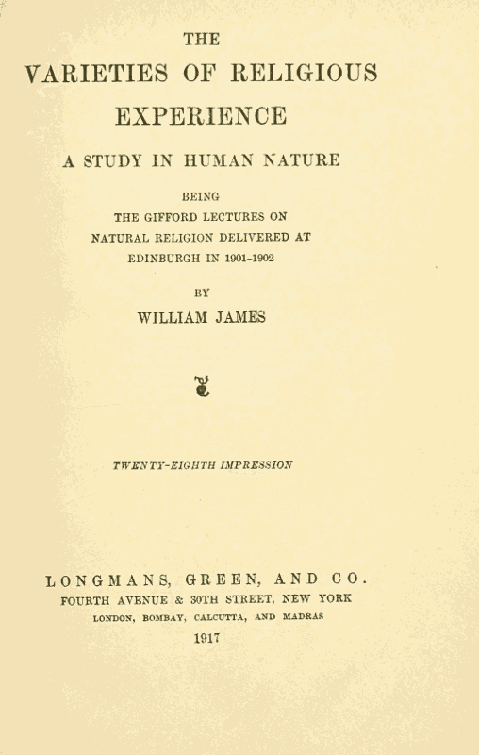
Philosophical approaches to religious consciousness and epistemology
William James, Varieties of Religious Experience, 1917 – interest in knowledge granting aspect of the religious experience and consciousness.
Philosophers have focused on:
Classifying mystical experiences
Their nature and manifestation in different religions and mystical traditions/settings
How much are mystical experiences conditioned by a mystic's culture and language
whether religious experiences provide evidence for the truth of their contents

Slide 12
The Unknown Experienced Other/Divine
“As regards the origin of the Greek gods, we need not at present seek an opinion. But the whole array of our instances leads to a conclusion something like this: It is as if there were in the human consciousness a sense of reality, a feeling of objective presence, a perception of what we might call “something there” by which the current psychology supposes existent realities be originally revealed.” – William James, Varieties of Religious Experience, 1917
“It is the emotion of a creature, submerged and overwhelmed by its own nothingness in contrast to that which is supreme above all creatures” – Rudolf Otto, The Idea of the Holy, 1923

Slide 13
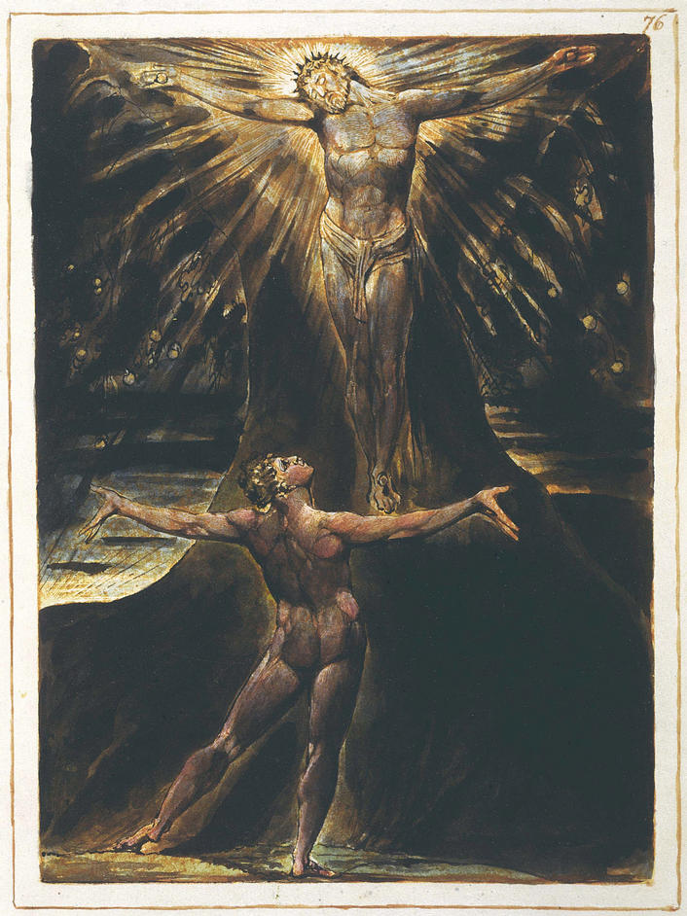
William Blake
I rest not from my great task!
To open the Eternal Worlds, to open the immortal Eyes
Of Man inwards into the Worlds of Thought: into Eternity
Ever expanding in the Bosom of God, the Human Imagination
O Saviour pour upon me thy Spirit of meekness and love!
Annihilate the Self hood in me: be thou all my life!
Guide thou my hand, which trembles exceedingly upon the rock of ages,
While I write of the building of Golgonooza
William Blake, Jerusalem, (5.17.26)

Slide 14
What can we know? How do we know it?
“Mysticism”/Religion
“Normal Science”
Intuition
Revelation
Inspiration
Received wisdom
“Eureka!”
Emotion/Feeling
Contemplation
Empiricism
Experimentation
Sense-Experience
Logic/Rationality
Observation
Verifiability

Slide 15
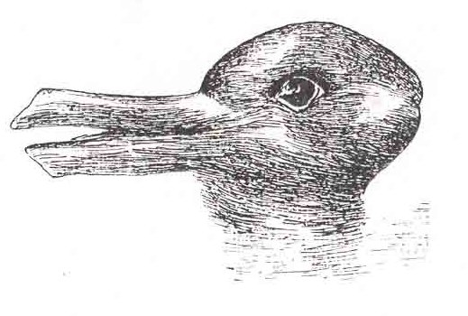
Structures of Scientific Revolutions Thomas Kuhn
“Normal science, the activity in which most scientists inevitably spend almost all their time, is predicated on the assumption that the scientific community knows what the world is like.”
“If these out-of date beliefs are to be called myths, then myths can be produced by the same sorts of methods and held for the same sorts of reasons that now lead to scientific knowledge.”
“What man sees depends both upon what he looks at and also upon what his previous visual-conception experience has taught him to see.”
Kuhn used this duck-rabbit optical illusion to demonstrate the way in which a paradigm shift could cause one to see the same information in an entirely different way – each view (either as duck or rabbit) is incommensurable.

Slide 16
Paradigm Shifts The Limits of Scientific Knowledge
“But what really set the cat among the philosophical pigeons was one implication of Kuhn's account of the process of paradigm change. He argued that competing paradigms are "incommensurable": that is to say, there exists no objective way of assessing their relative merits. There's no way, for example, that one could make a checklist comparing the merits of Newtonian mechanics (which applies to snooker balls and planets but not to anything that goes on inside the atom) and quantum mechanics (which deals with what happens at the sub-atomic level). But if rival paradigms are really incommensurable, then doesn't that imply that scientific revolutions must be based – at least in part – on irrational grounds? In which case, are not the paradigm shifts that we celebrate as great intellectual breakthroughs merely the result of outbreaks of mob psychology?”
John Naughton, “Thomas Kuhn: the man who changed the way the world looked at science,” The Guardian, 18 August 2012.

Slide 17
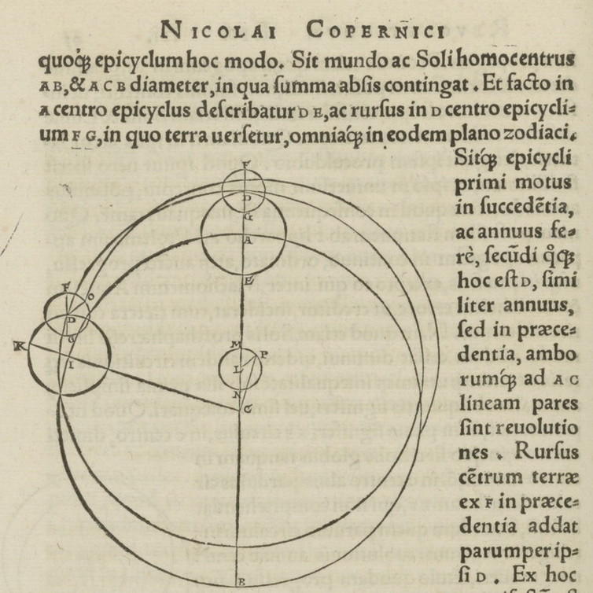
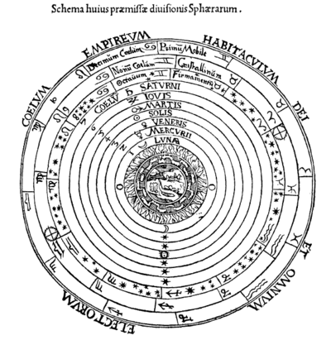
Paradigm shifts and planetary orbit using epicycles to “patch up” geocentric paradigms

Slide 18
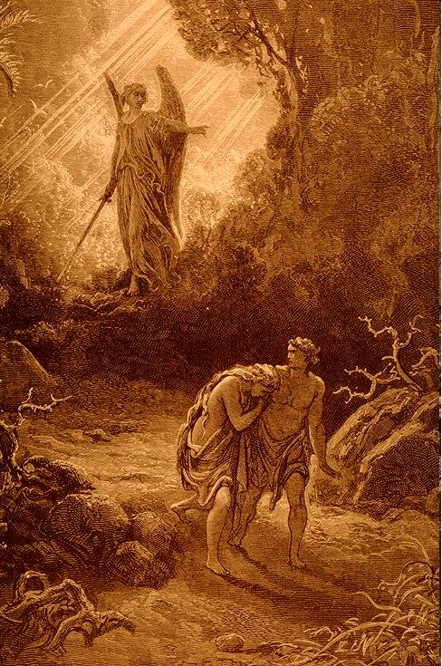
The Fall as a severance from union with the divine Intuition/Feeling vs. Logic/Intellectualism
Unto the woman he said, I will greatly multiply thy sorrow and thy conception; in sorrow thou shalt bring forth children.
Genesis 3:16
Cursed is the ground because of you; through painful toil you will eat food from it all the days of your life. It will produce thorns and thistles for you, and you will eat the plants of the field. By the sweat of your brow will you have food to eat until you return to the ground from which you were made. For you were made from dust, and to dust you will return.
Genesis 3:17-19
Labouring the soile, and reaping plenteous crop,
Corn wine and oyle; and from the herd or flock,
Oft sacrificing Bullock, Lamb, or Kid
John Milton, Paradise Lost

